Slide 1
Semi-inclusive DIS Physics with SoLID
J. P. Chen , Jefferson Lab
Hall A&C Collaboration Meeting, JLab, June 5-6, 2014
Introduction
Spin-flavor and SIDIS
TMDs with 6 GeV JLab: Exploration
Recent and new results with a transversely Polarized ³He (n)
SoLID Program on TMDs
Map multi-dimensional structure of the nucleon in the valence quark
region with ultimate precision

Slide 2
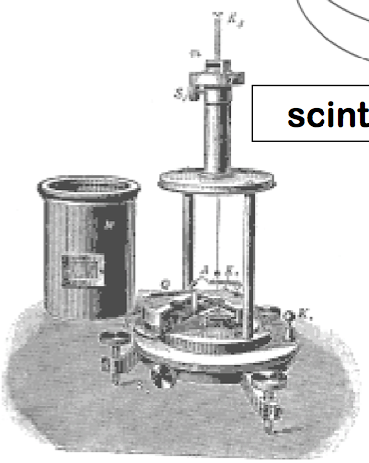
EM Interaction
atom
Strong Int. “Residual”
electron
nucleus
~10⁻¹⁰ m
Strong Int.
~keV
nucleon (proton/neutron)
~10⁻¹⁴ m
~MeV
< 10⁻¹⁸ m
~10⁻¹⁵ m
quark
~GeV

Slide 3
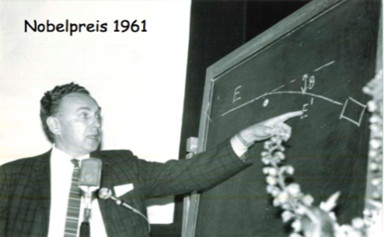
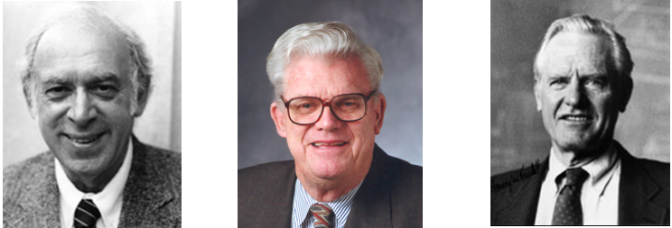
Electron Scattering and Nucleon Structure
1960s: Discovery: Proton Has Internal Structure
elastic electron scattering
Nucleon Form Factors -> EM Distributions
1970s: Discovery of Quarks (Partons)
inclusive deep-inelastic scattering (DIS)
Structure Functions -> Parton Distributions
1980s: “Spin Crisis”
Spin Distributions, Spin Flavor, Spin Sum Rule
2000s: 3-d Structure: TMDs and GPDs
Robert Hofstadter,
Nobel Prize 1961
J.T. Friedman R. Taylor H.W. Kendall
Nobel Prize 1990

Slide 4
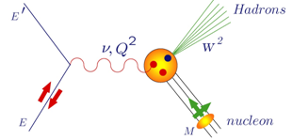
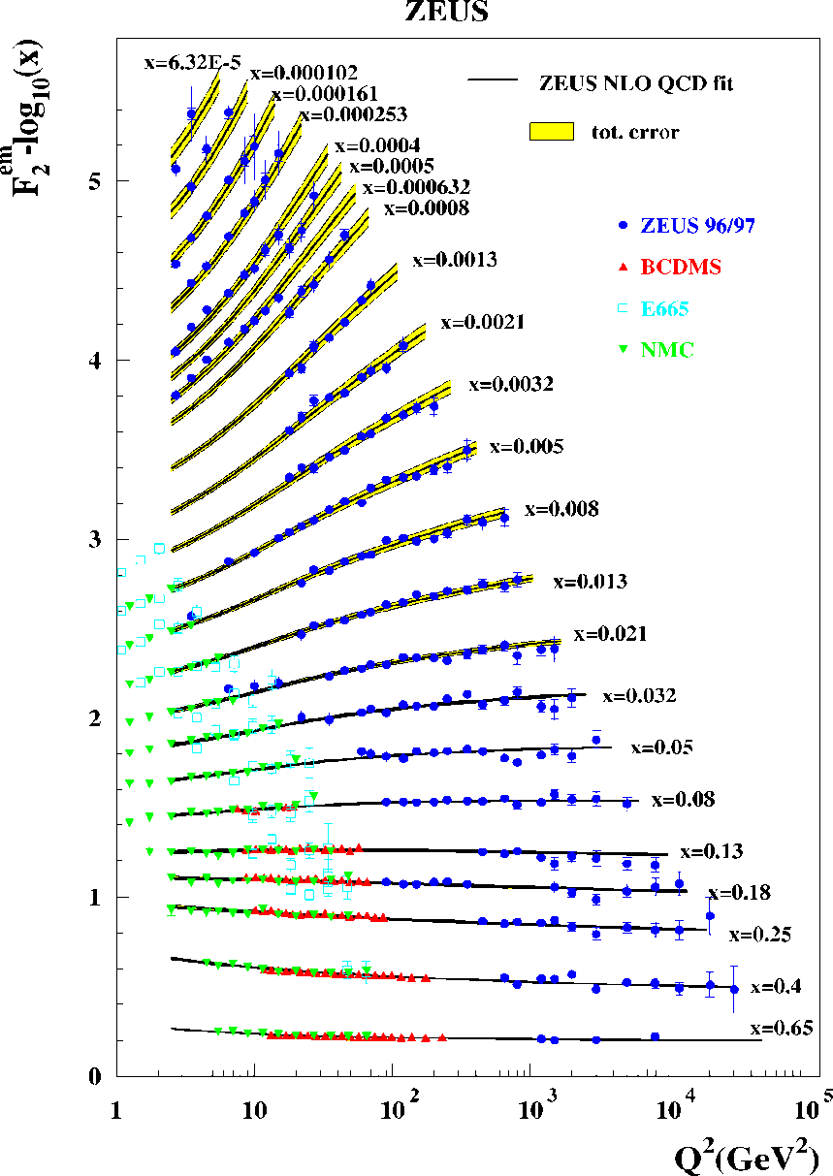
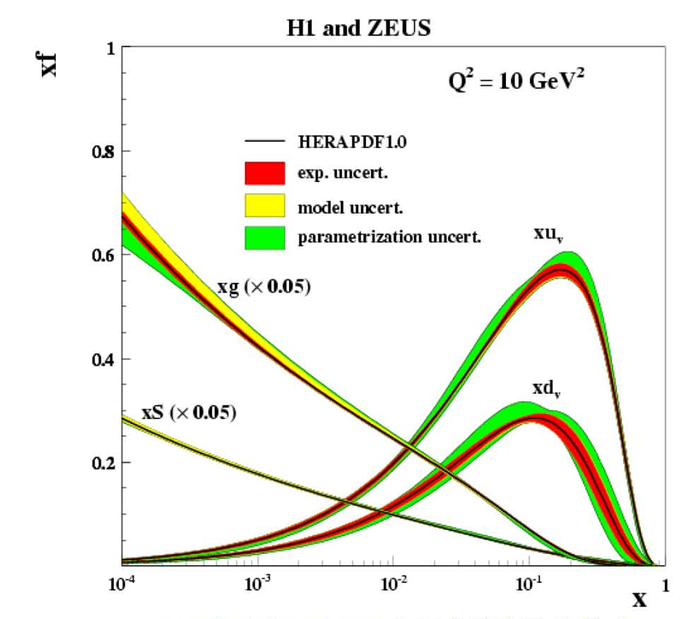
Nucleon Structure Function: Deep-Inelastic Scattering
Bjorken Scaling and Scaling Violation
Gluon radiation – QCD evolution
One of the best experimental tests of QCD

Slide 5
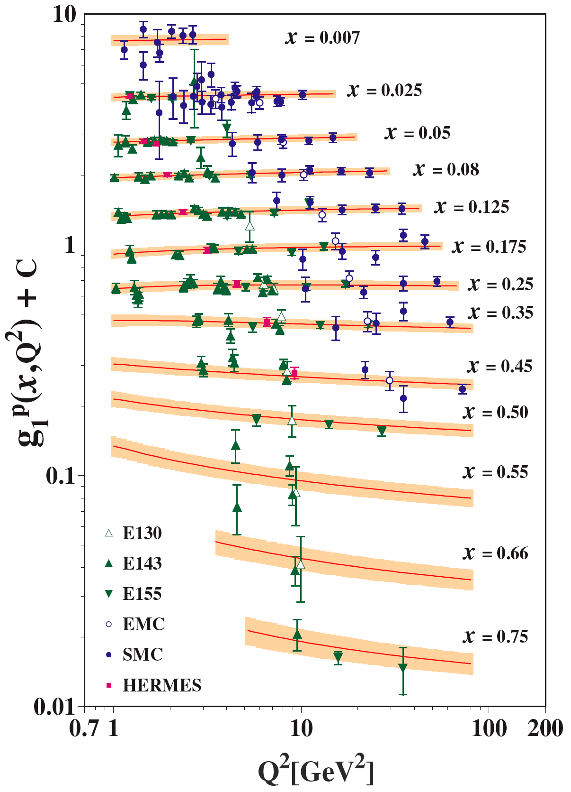
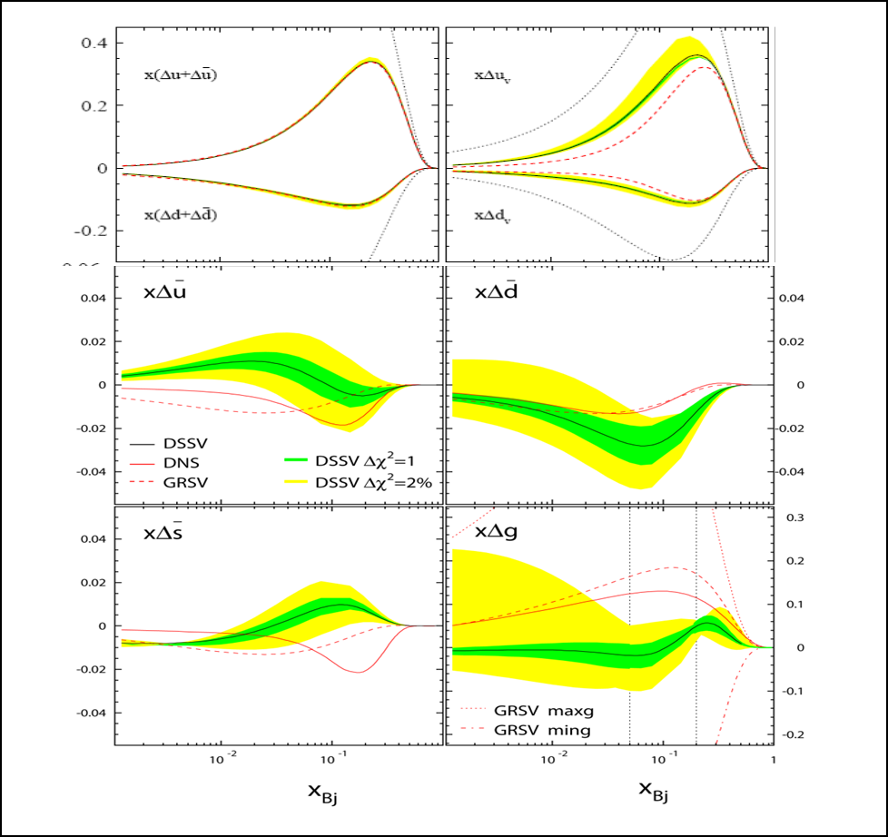
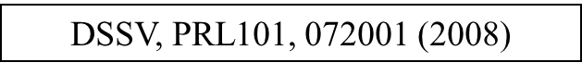
Polarized Structure Function/Distributions

Slide 6
Spin Flavor with JLab12
Inclusive DIS: Valance Quark Spin
SIDIS: Sea Quark Spin

Slide 7
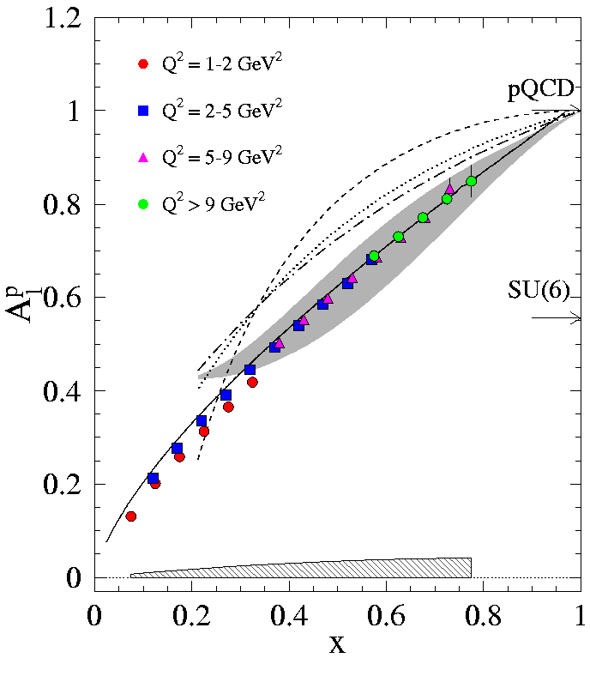
Inclusive Spin-Flavor at JLab12
A₁^{p} at 11 GeV

Slide 8
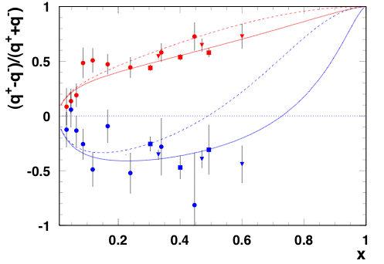
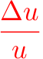
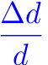
Spin-Flavor and Large x Behavior
H. Avakian, S. Brodsky, A. Deur, and F. Yuan, PRL 99, 082001 (2007)
Inclusive Hall A and B and Semi-Inclusive Hermes

Slide 9
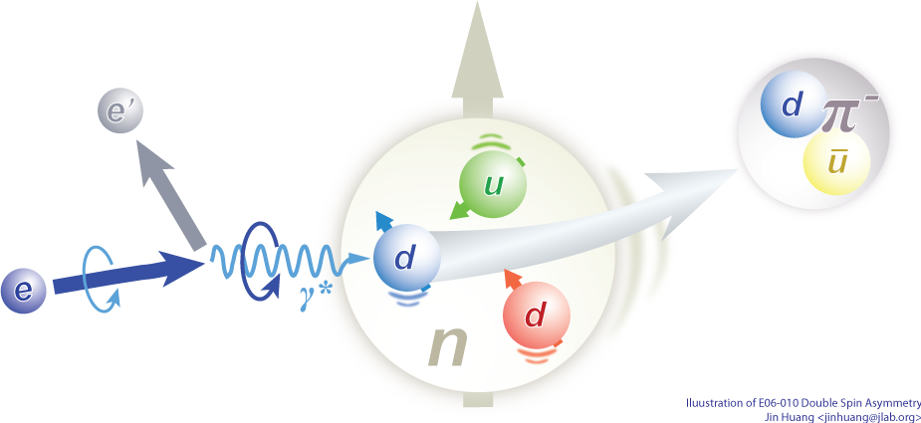
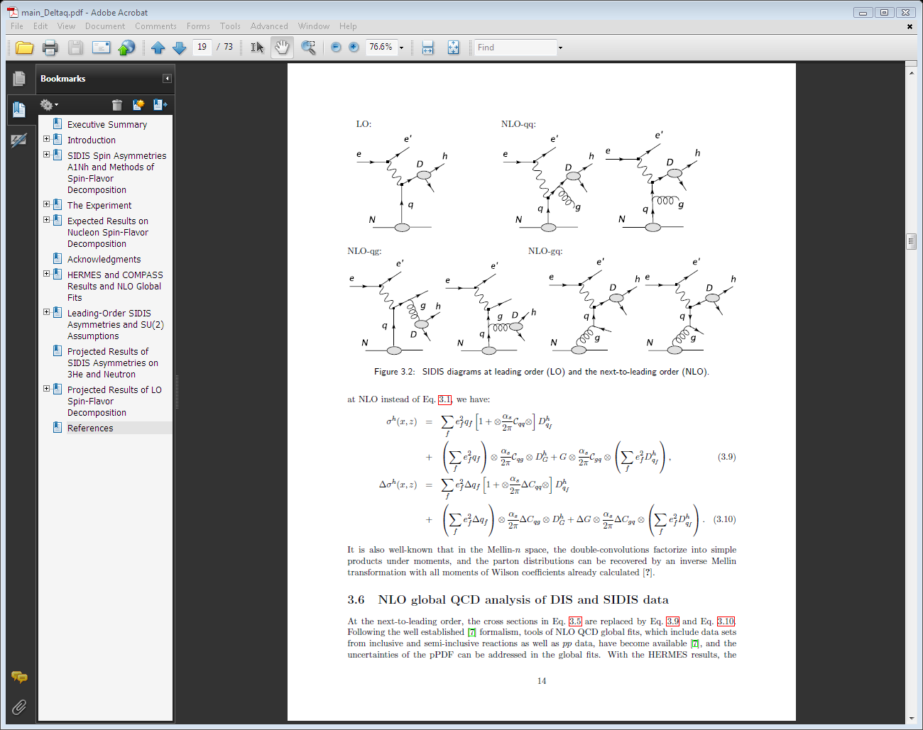
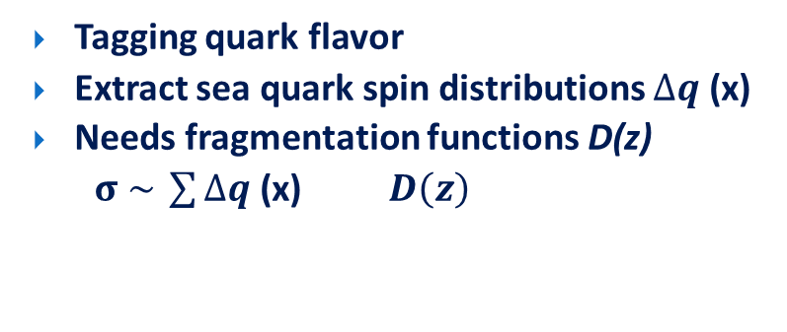
Semi-inclusive DIS (SIDIS): Spin-Flavor
Tagging quark flavor
Extract sea quark spin distributions $∆q$ (x)
Needs fragmentation functions D(z)
$σ \sim \sum{∆q}$ (x) $D\left(z\right)$
Notes:
! SIDIS -> conv. PDF & FF
Introduction to DIS and its variables
Introduction to azimuthal angle
Factorized at Q^2>>p_T>>QCD scale

Slide 10
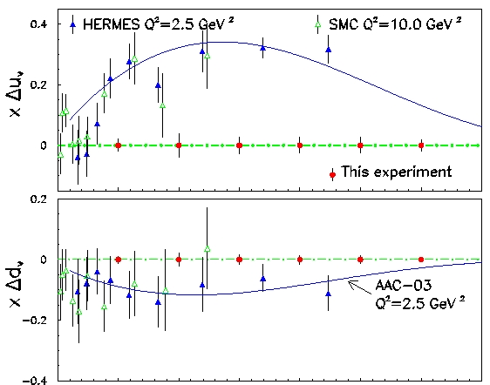
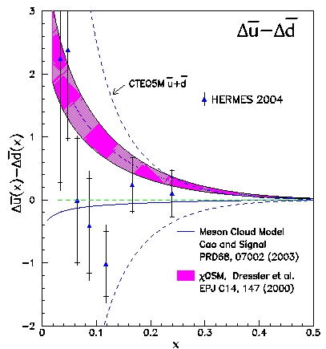
Flavor decomposition with SIDIS
Δu and Δd at JLab 11 GeV
Polarized Sea
JLab @11 GeV

Slide 11
Transversity and TMDs with SIDIS
Single Spin Asymmetries with
Transversely Polarized Targets

Slide 12
Transversity and TMDs
Three twist-2 quark distributions:
Momentum distributions: q(x,Q²) = q↑(x) + q↓(x)
Longitudinal spin distributions: Δq(x,Q²) = q↑(x) - q↓(x)
Transversity distributions: δq(x,Q²) = q┴(x) - q┬(x)
Tensor charge: Lattice QCD predictions
It takes two chiral-odd objects to measure transversity
Semi-inclusive DIS
Chiral-odd distributions function (transversity)
Chiral-odd fragmentation function (Collins function)
TMDs: (without integrating over P_{T})
Distribution functions depends on x, k┴ and Q² : δq, f_{1T}┴ (x,k┴ ,Q²), …
Fragmentation functions depends on z, p┴ and Q² : D, H₁(x,p┴ ,Q²)
Measured asymmetries depends on x, z, P┴ and Q² : Collins, Sivers, …
TMDs provide very rich, more complete information on 3-d structure in momentum space and access quark orbital angular momentum.

Slide 13




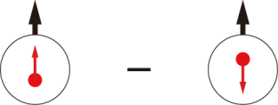
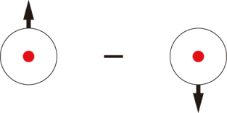
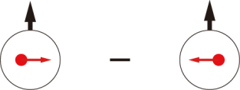
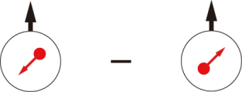
Leading-Twist TMD PDFs
 |  | Quark polarization
 |  | Unpolarized (U) | Longitudinally Polarized (L) | Transversely Polarized (T)
Nucleon Polarization | U
 | L
 | T
f₁ =
h₁⊥ =
Boer-Mulders
h_{1L}⊥ =
g₁ =
Helicity
Worm Gear
h₁ =
f _{1T}⊥ =
Transversity
g_{1T} =
Sivers
h_{1T}⊥ =
Worm Gear
Pretzelosity
Nucleon Spin
: Probed with transversely pol target
HERMES, COMPASS, JLab E06-010
Quark Spin
Notes:
! relate g1, f1 -> collinear w/ pT dep.
Say: Noval new information on structure of nucleon, spin-orbital cor and multi-parton cor.

Slide 14
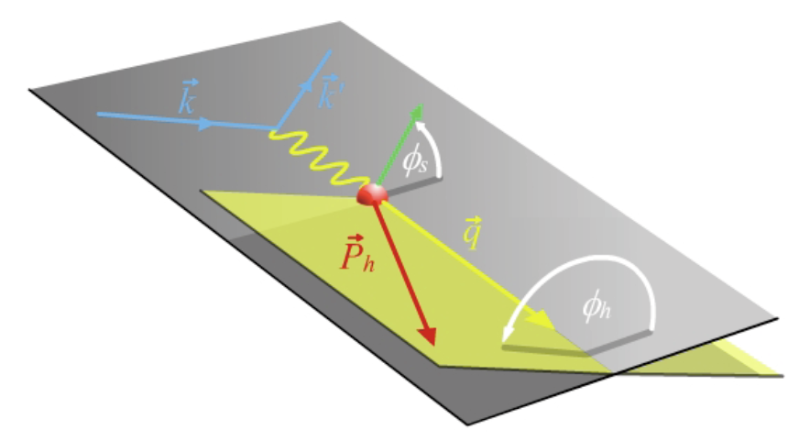
Tool: Semi-inclusive DIS (SIDIS)
Gold mine for TMDs
Access all eight leading-twist TMDs through spin-comb. & azimuthal-modulations
Tagging quark flavor/kinematics
Scattering Plane
Notes:
! SIDIS -> conv. PDF & FF
Introduction to DIS and its variables
Introduction to azimuthal angle
Factorized at Q^2>>p_T>>QCD scale

Slide 15
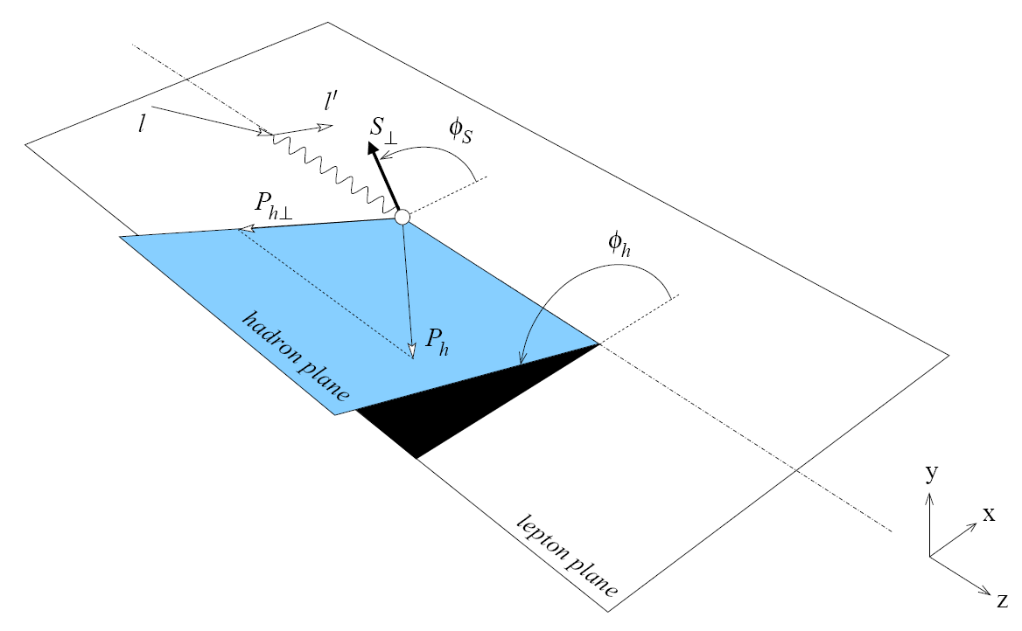
SIDIS: Separation of Collins, Sivers and pretzelocity effects through angular dependence

Slide 16
Status of Transversity/TMD Study
Large single spin asymmetry in pp->πX (Fermi, RHIC-spin)
Collins Asymmetries
- sizable for the proton (HERMES and COMPASS)
large at high x, π⁻ and π+ has opposite sign
unfavored Collins fragmentation as large as favored (opposite sign)?
- consistent with 0 for the deuteron (COMPASS)
Sivers Asymmetries
- non-zero for π⁺ from proton (HERMES), new COMPASS data
- large for K⁺ ?
Collins fragmentation functions from Belle/BaBar
Global Fits/models: Anselmino et al., Yuan et al., Pasquini et al., Ma et al., …
Very active theoretical and experimental efforts
JLab (6 GeV and 12 GeV), RHIC-spin, Belle, FAIR, J-PARC, EIC, …
First neutron measurement from Hall A 6 GeV (E06-010)
SoLID with polarized n(³He) and p at JLab 12 GeV
Unprecedented precision with high luminosity and large acceptance

Slide 17
Single Spin Asymmetries with
A Transversely Polarized ³He (n)
JLab Hall A E06-010
Published and New Results
From SIDIS and Inclusive Reactions

Slide 18
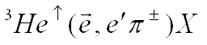
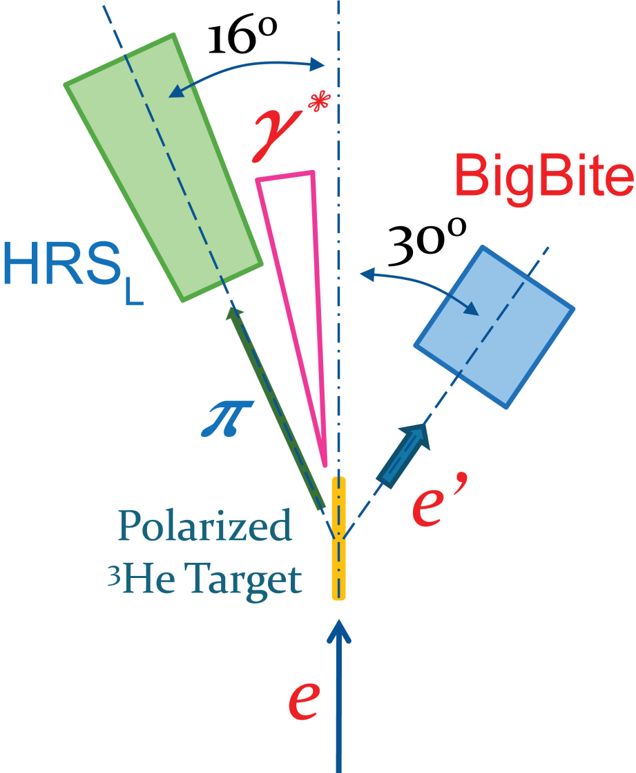
E06‑010 Experiment
Spokespersons: J. P. Chen, E. Cisbani, H. Gao, X. Jiang and J. C. Peng
7 PhD Thesis Students (graduated) + 2 new students
Luminosity
Monitor
First measurement on n (³He)
Transversely Polarized ³He Target
Polarized Electron Beam, 5.9 GeV
BigBite at 30º as Electron Arm
P_{e} = 0.7 ~ 2.2 GeV/c
HRS_{L} at 16º as Hadron Arm
P_{h} = 2.35 GeV/c
Excellent PID for π/K/p
Beam Polarimetry
(Møller + Compton)
Notes:
What’s new:
Neutron Target
Helicity Flip -> Cancel drift/cancel false asym.
Beam charge feed back -> PPM level Charge Asym

Slide 19
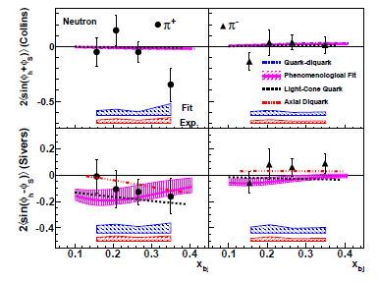
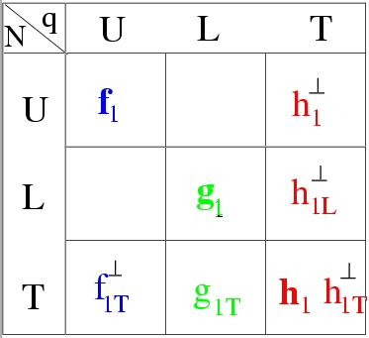
³He (n) Target Single-Spin Asymmetry in SIDIS
E06-010 collaboration, X. Qian at al., PRL 107:072003(2011)
neutron Collins SSA small
Non-zero at highest x for π+
neutron Sivers SSA:
negative for π^{+,}
Agree with Torino Fit
Blue band: model (fitting) uncertainties
Red band: other systematic uncertainties

Slide 20
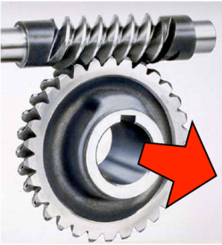
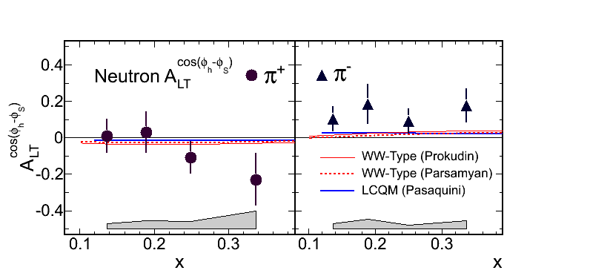
Asymmetry A_{LT} Result
J. Huang et al., PRL. 108, 052001 (2012).
To leading twist:
Worm-Gear
Trans helicity
Dominated by L=0 (S) and L=1 (P) interference
neutron A_{LT :} Positive for π-
Consist w/ model in signs, suggest larger asymmetry
Notes:
Physics meaning
If Non zero on neutron -> existence of angular momentum?

Slide 21
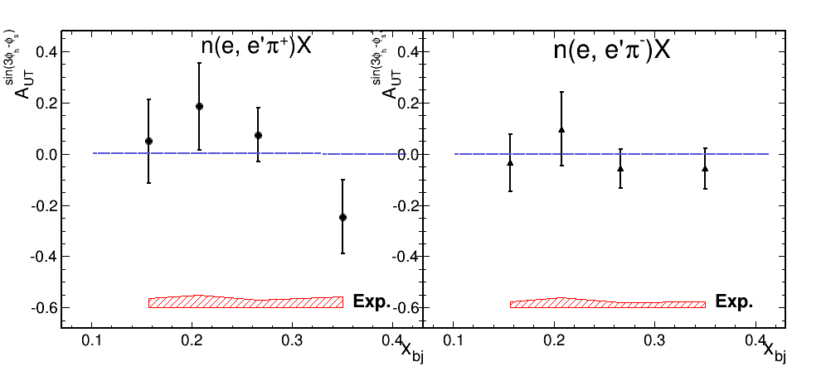
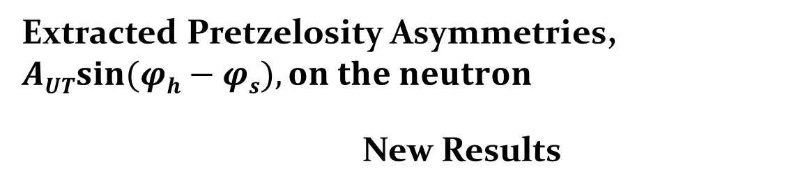
Pretzelosity Results on Neutron
Analysis by Y. Zhang (Lanzhou) and X. Qian (Caltech)
Extracted Pretzelosity Asymmetries, $\operatorname{AUTsin}{(φh}−φs), on the neutron$
New Results
In models, directly related to OAM,
L=0 and L=2
interference
submitted to PRC, arXiv:1312.3047

Slide 22
E06-010: Inclusive Hadron SSA (A_{N})
K. Allada et al, PRC 89, 042201 (2014)
Clear non-zero vertical target SSA
Opposite sign for π⁺ and π⁻
Large for K⁺
Results consistent with predictions based on Sivers mechanism
vertical target

Slide 23
Future: TMD study @ 12 GeV JLab
Precision Study of TMDs
In the Valence Quark Region

Slide 24
JLab 12 GeV Era: Precision Study of TMDs
From exploration to precision study with 12 GeV JLab
Transversity: fundamental PDFs, tensor charge
TMDs: 3-d momentum structure of the nucleon
→ Quark orbital angular momentum
Multi-dimensional mapping of TMDs
4-d (x,z,P┴,Q²)
Multi-facilities, global effort
Precision → high statistics
high luminosity and large acceptance

Slide 25
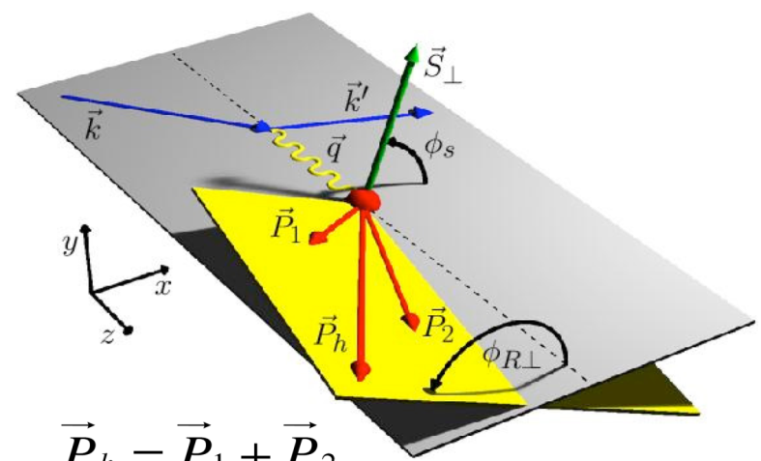

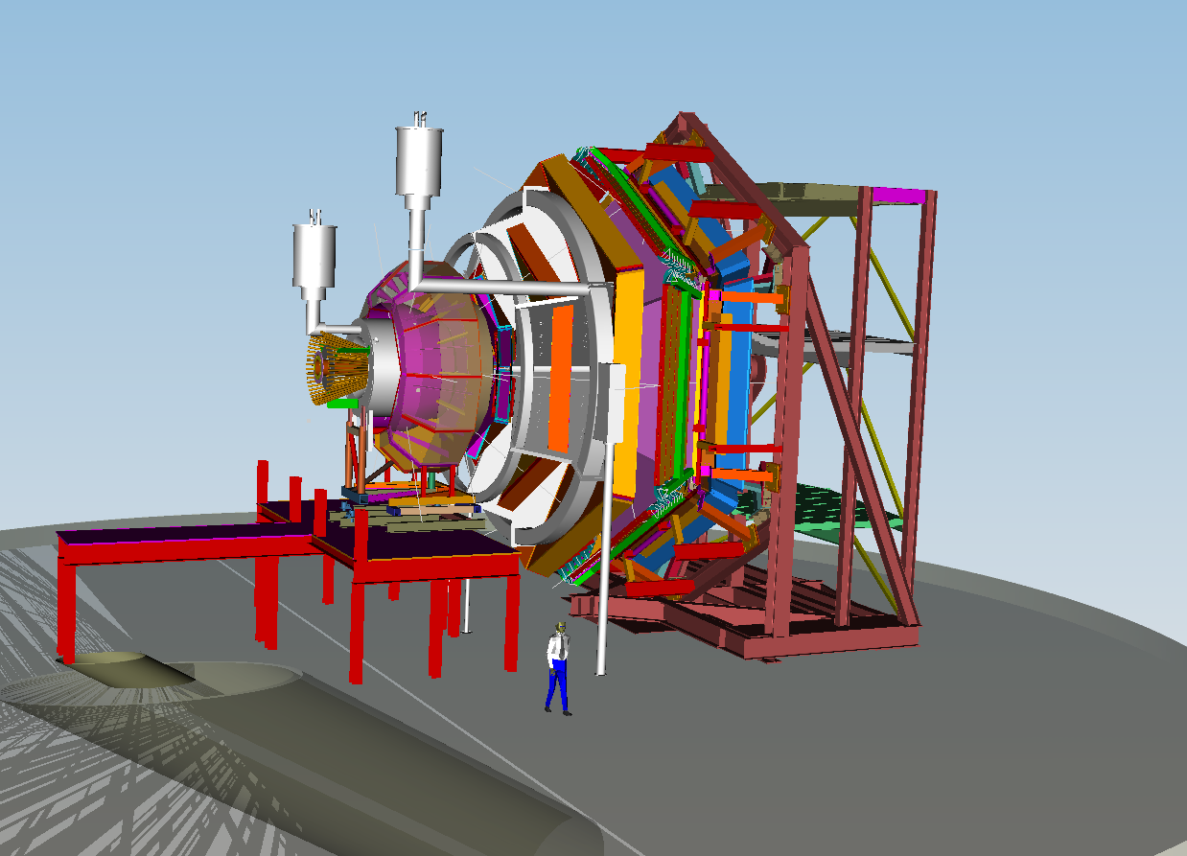

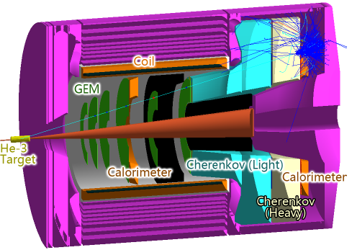
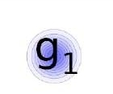
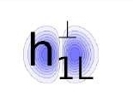

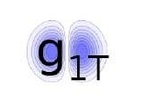
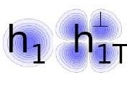
Multi-Halls SIDIS Program
Hall A/SBS
High x - Q², 2-3D
Hall B/CLAS12
General survey, medium luminosity
Hall C/SHMS
L-T studies, precise π⁺/π⁻ ratios
Hall A/SOLID
High Lumi and acceptance – 4D
q
N
U
L
T
U
L
T
H₂/D₂,
NH₃/ND₃, HD
H₂ D₂
³He, NH₃

Slide 26
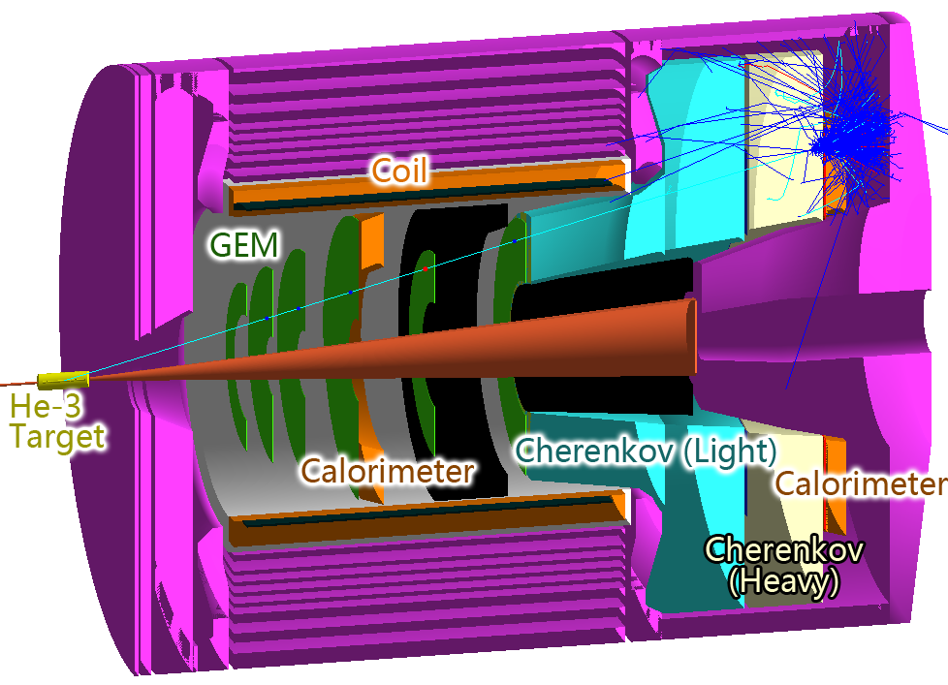
SoLID for SIDIS/PVDIS with 12 GeV JLab
Exciting physics program:
Five approved experiments:
three SIDIS “A rated”, one PVDIS “A rated”, one J/Psi “A- rated”
International collaboration: nine countries and 50+ institutions
GEMs for tracking
Cherenkov and EM Calorimeter for electron PID
Heavy Gas Cherenkov and MRPC (TOF) for pion PID
CLEOII Magnet (official)
pCDR completed, finalizing cost

Slide 27
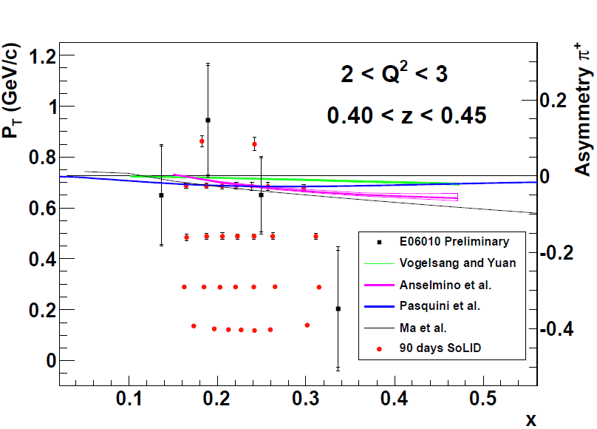
Mapping of Collins(Sivers) Asymmetries with SoLID E12-10-006 (n) Spokespersons: J. P. Chen, H. Gao, X. Jiang, J. C. Peng and X. Qian E12-11-108(p): K. Allada, J. P. Chen, H. Gao, X. Li and Z. E. Meziani Both Approved with “A” Rating
Both π+ and π-
Precision Map in
x(0.05-0.65), z(0.3-0.7),
Q²(1-8), P_{T}(0-1.6)
Extract tensor charge for d and u quarks
Study quark orbital motion
Collins (Sivers) Asymmetries

Slide 28
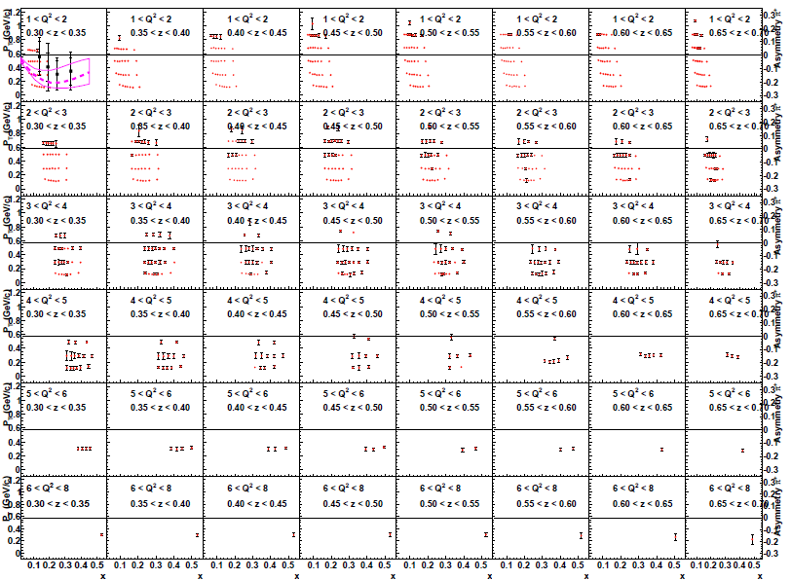
Map Collins and Sivers asymmetries in 4-D (x, z, Q², P_{T})

Slide 29
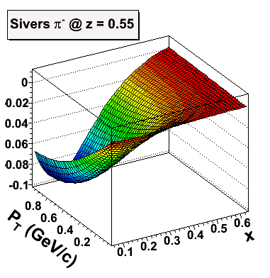
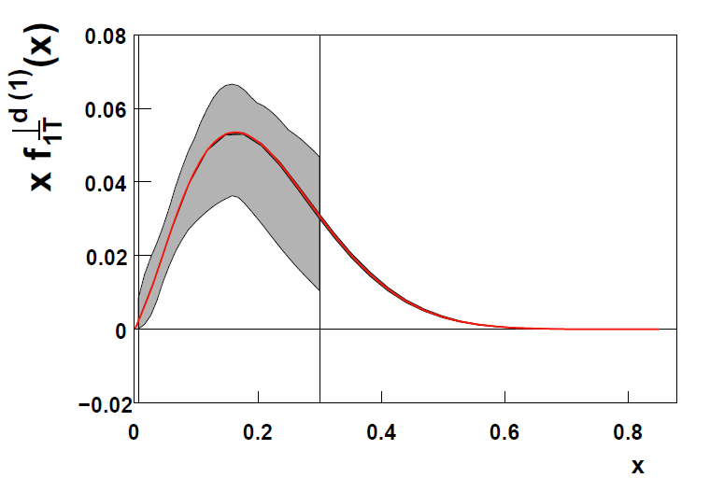
Expected Improvement: Sivers Function
f _{1T}⊥ =
Significant Improvement in the valence quark (high-x) region
Illustrated in a model fit (from A. Prokudin)

Slide 30
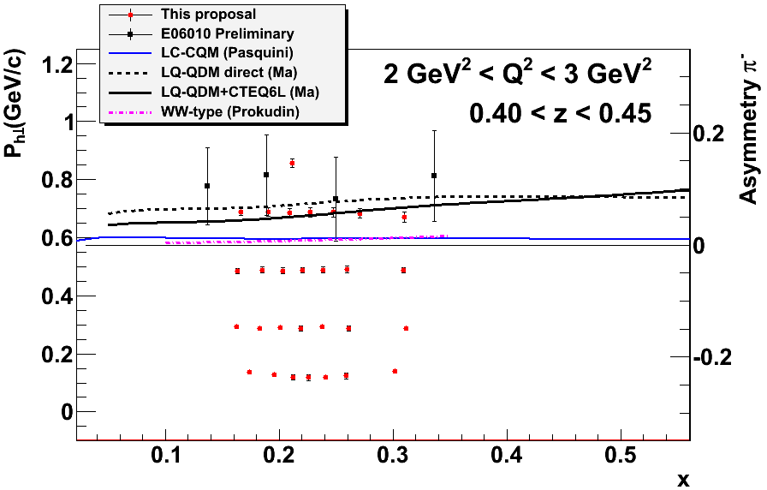
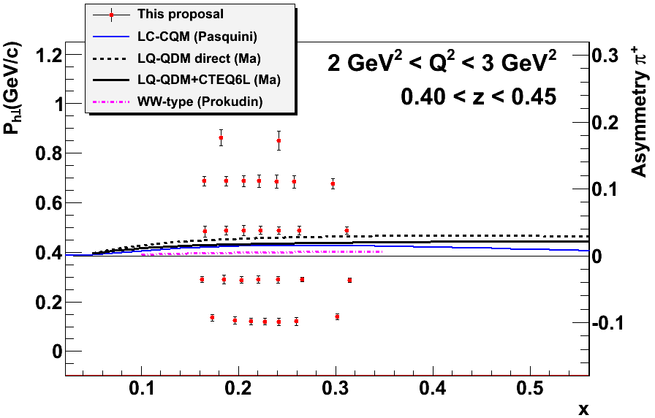
E12-11-107: Worm-gear functions (A rating ) Spokespersons: J. P. Chen, J. Huang, Y. Qiang and W. Yan
h_{1L}⊥ =
g_{1T} =
Dominated by real part of interference between L=0 (S) and L=1 (P) states
No GPD correspondence
Lattice QCD -> Dipole Shift in mom. space.
Model Calculations -> h_{1L}⊥ =? -g_{1T} .
Longi-transversity
Trans-helicity
Center of points:

Slide 31
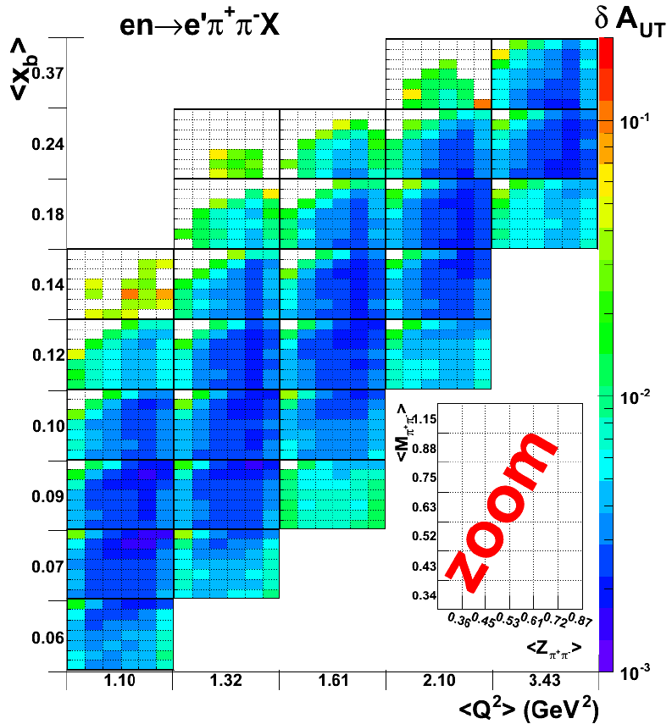
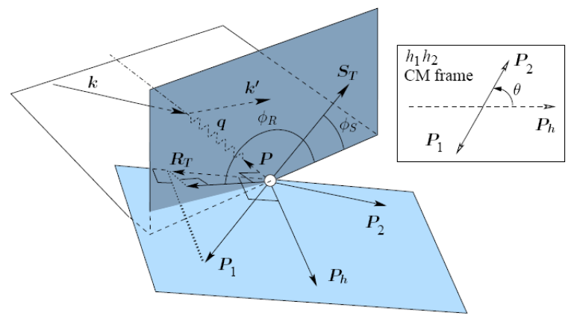
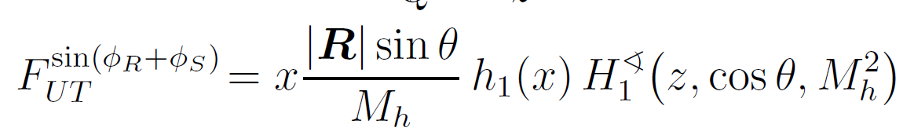
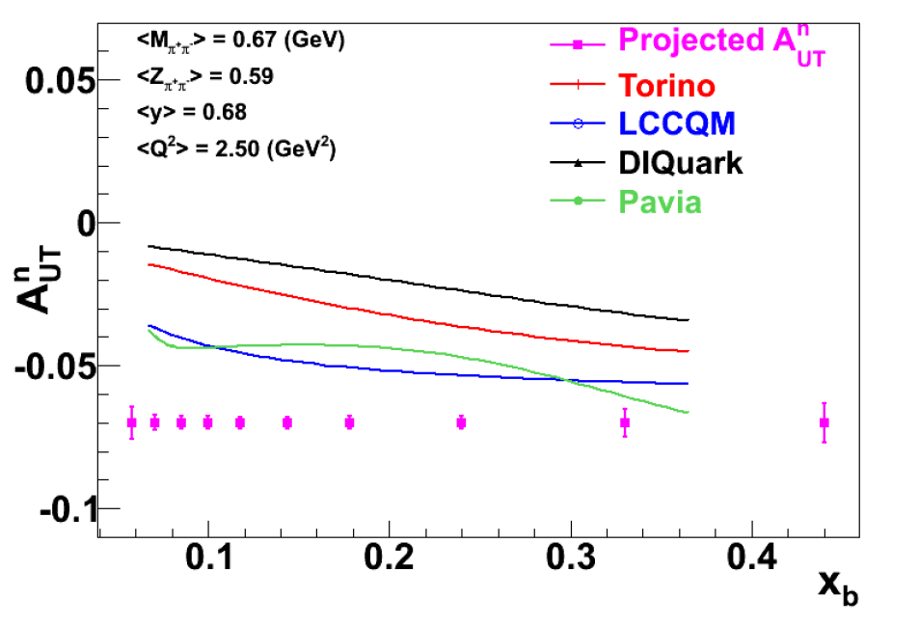
New Proposal: Dihadron in DIS on ³He Spokespersons: J. Zhang, J. P. Chen, A. Courtoy, H. Gao and Z. Xiao
Access transversity in transversely polarized neutron target through π⁺ π⁻ di-hadron production
Run simultaneously with SIDIS ³He (e,e’π±)X
Systematical check of two approaches to access h₁
Asymmetry projection for one M-z bin

Slide 32
Summary on SoLID TMD Program
Unprecedented precision 4-d mapping of SSA
Collins, Sivers, Pretzelosity and Worm-Gear
Both polarized ³He (n) and polarized proton
Three “A” rated experiments approved. A new proposal: di-hadron
Combining with the world data
extract transversity and fragmentation functions for both u and d quarks
determine tensor charges
study TMDs for valence quarks
learn quark orbital motion and quark orbital angular momentum
study Q² evolution
much better understanding of multi-d nucleon structure and QCD
SoLID: large project, active
welcome new collaborators

Slide 33
Other SoLID Experiments
PVDIS, J/ψ

Slide 34


PVDIS with SoLID Contact Person: P. Souder
High Luminosity on LD2 and LH2
Better than 1% errors for small bins over large range kinematics
Test of Standard Model
Quark structure:
charge symmetry violation
quark-gluon correlations
d/u at large-x

Slide 35




12 GeV PVDIS Sensitivity: C₁ and C₂ Plots
World’s data
6 GeV
PVDIS
Precision Data
Qweak
PVDIS
Cs

Slide 36




SoLID-J/ψ: Study Non-Perturbative Gluons
Spokespersons: K. Hafidi, Z.E. Meziani, X. Qian,
N. Sparveris and Z. Zhao
J/ψ: ideal probe of non-perturbative gluon
The high luminosity & large acceptance capability of SoLID enables a unique “precision” measurement near threshold
Search for threshold enhancement
Shed light on the conformal anomaly
Trace Anomaly
Gluon Energy
50 days @ 10³⁷ N/cm²/s
Quark Energy
Quark Mass
X. Ji PRL 74 1071 (1995)

Slide 37
Summary
SIDIS a powerful tool to study spin-flavor and TMDs
Nucleon TMD study have been exciting and fruitful
Recent and New Results on TMD studies from JLab
Planned SoLID program on TMDs
Precision 4-d mapping of TMD asymmetries
Extraction of transversity and tensor charge
Extraction of Sivers/g₁^{T}: study quark orbital angular menmentum
Precision experimental data + development in theory for Nucleon TMDs +…
lead to breakthrough in understanding QCD?
Other Solid Experiments: PVDIS and J/Ψ

